Slide 1


Upper Coastal Plain Rural Planning Organization (UCPRPO)
TAC Meeting
March 9, 2022
Edgecombe County - Johnston County – Nash County – Wilson County
The meeting will begin at 3:00 PM
Please mute your line if you have not already done so.

Slide 2
UCPRPO TAC Meeting
Edgecombe County - Johnston County – Nash County – Wilson County
March 9, 2022
Meeting Guidelines
Please keep your microphone on mute until you are ready to make a comment or ask a questions.
Turn your microphone on to speak but remember to turn it off once you have finished.
Begin with stating your name so everyone will know who is speaking.
You may use the chat feature to send a note. The chat will be checked, but please get my attention if I fail to respond quickly.
All votes will be completed by roll call as per NCGS 166A-19.24(b)(5). When the chair calls for a vote, I will call roll and ask each person to respond with a ‘yes’ or ‘no’.
Please remember to mute yourself again after roll call.
Please keep microphone muted
Chat is enabled

Slide 3
UCPRPO TAC Meeting
Edgecombe County - Johnston County – Nash County – Wilson County
March 9, 2022
1. Welcome & Introductions – C.B. Brown – TAC Chair
2. ETHICS AWARENESS & CONFLICT OF INTEREST REMINDER
In accordance with the State Government Ethics Act, it is the duty of every [Board] member to avoid conflicts of interest.
Does any [Board] member have any known conflict of interest with respect to any matters coming before the [Board] today?
If so, please identify the conflict and refrain from any participation in the particular matter involved.
REMINDER: ETHICS FILINGS ARE DUE ON FRIDAY, APRIL 15, 2022

Slide 4
UCPRPO TAC Meeting
Edgecombe County - Johnston County – Nash County – Wilson County
March 9, 2022
3. APPROVAL OF UCPRPO TAC MEETING AGENDA
Looking for a motion and a 2nd to accept agenda….. Then roll call

Slide 5
UCPRPO TAC Meeting
Edgecombe County - Johnston County – Nash County – Wilson County
March 9, 2022
4. APPROVAL OF UCPRPO TAC MEETING MINUTES
Review and approval of the January 12, 2022 minutes with a motion and second….. Then roll call

Slide 6
UCPRPO TAC Meeting
Edgecombe County - Johnston County – Nash County – Wilson County
March 9, 2022
5. Clean Cities Coalition Presentation
By:
Heather Brutz, Clean Transportation Extension Specialist
North Carolina Clean Energy Technology Center
North Carolina State University
Office: 919-515-0352
Cell: 919-949-4094
sklunsfo@ncsu.edu

Slide 7
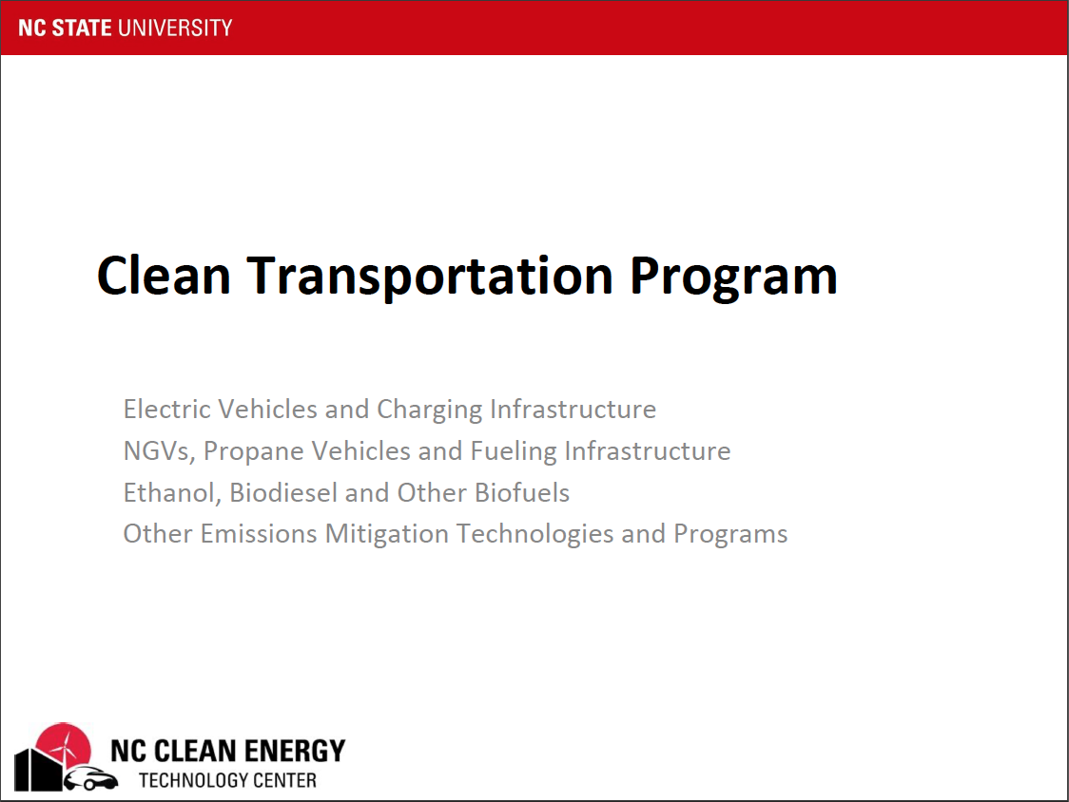
Clean Transportation Program
Electric Vehicles and Charging Infrastructure NGVs, Propane Vehicles and Fueling Infrastructure Ethanol, Biodiesel and Other Biofuels
Other Emissions Mitigation Technologies and Programs

Slide 8
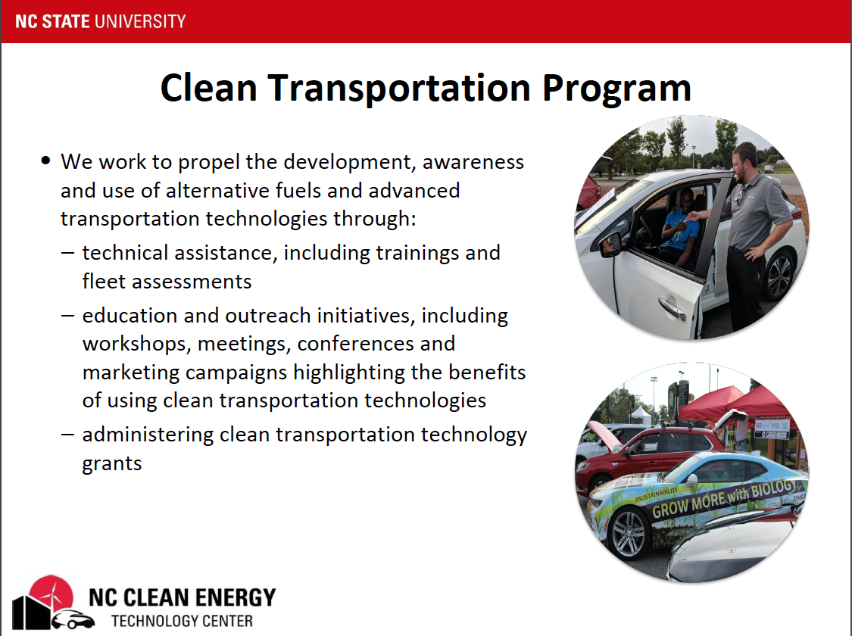

Slide 9
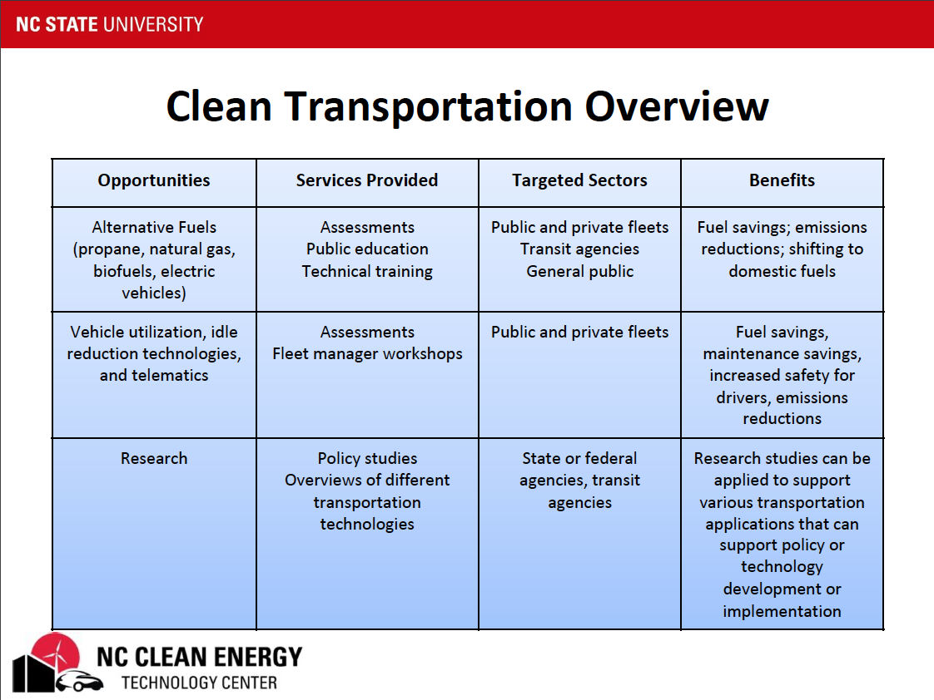

Slide 10
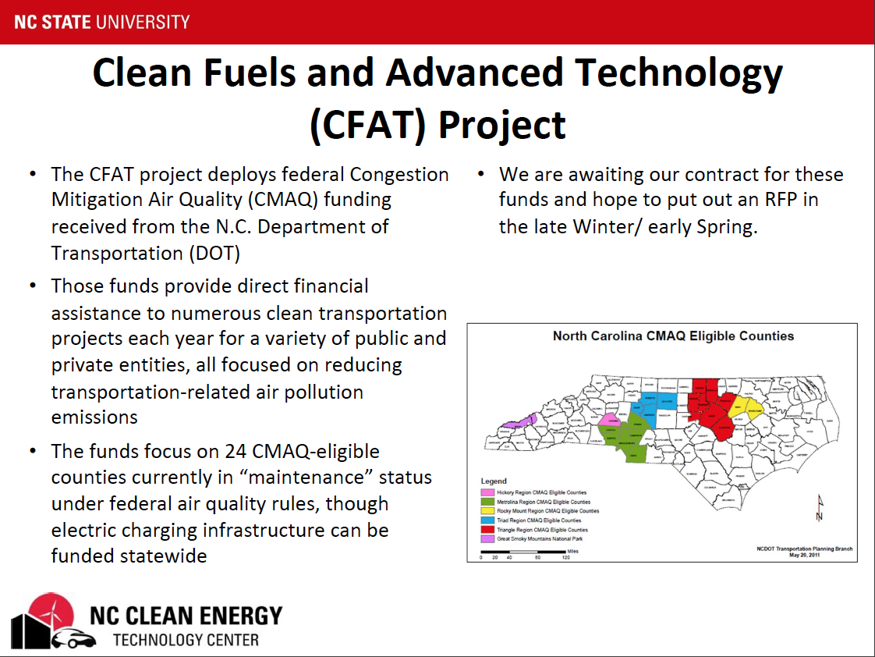

Slide 11
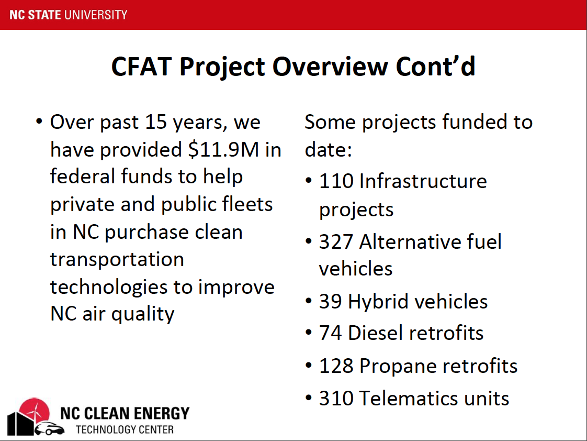

Slide 12


Slide 13
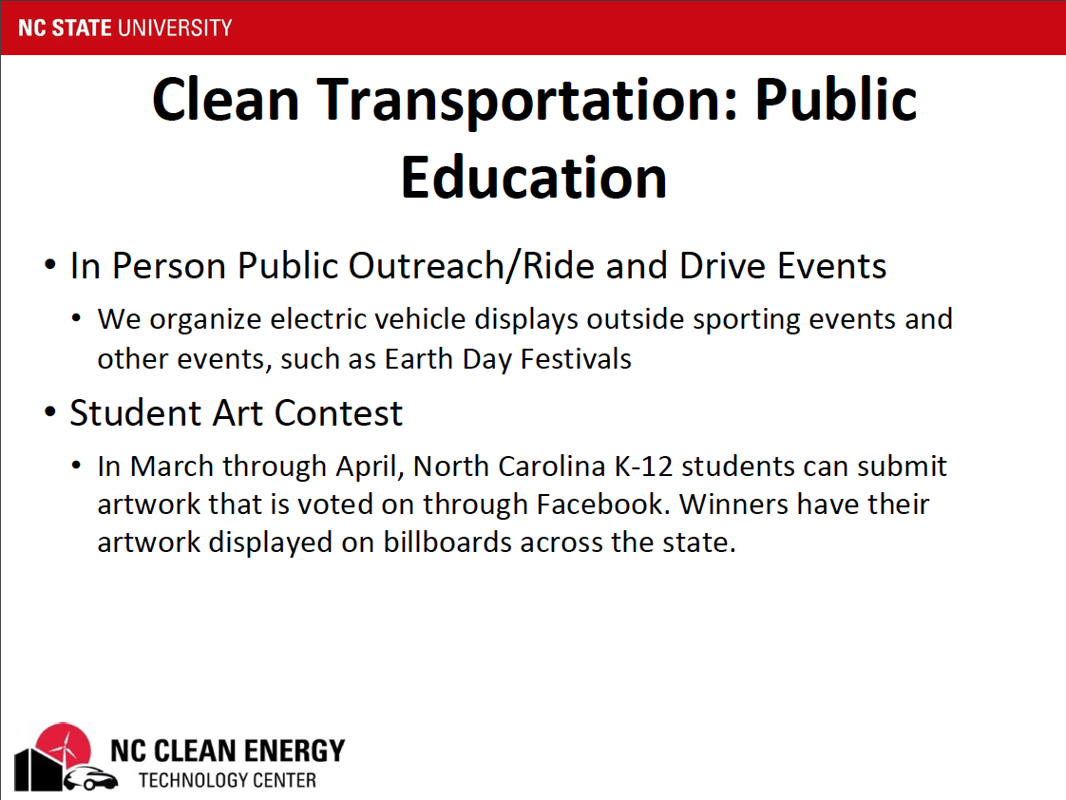

Slide 14
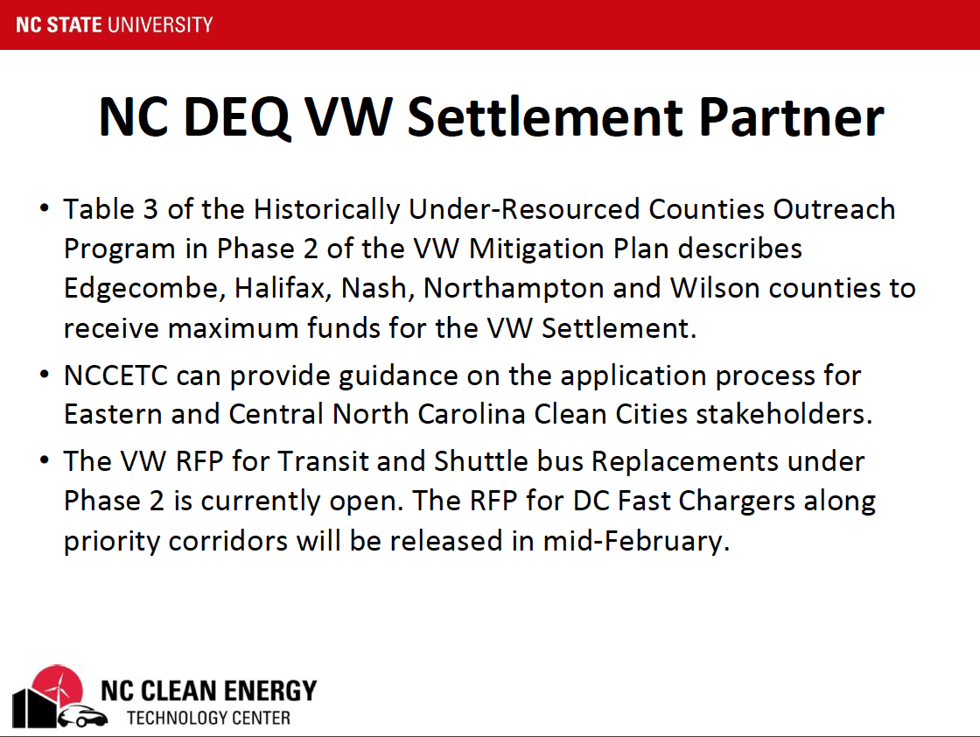

Slide 15
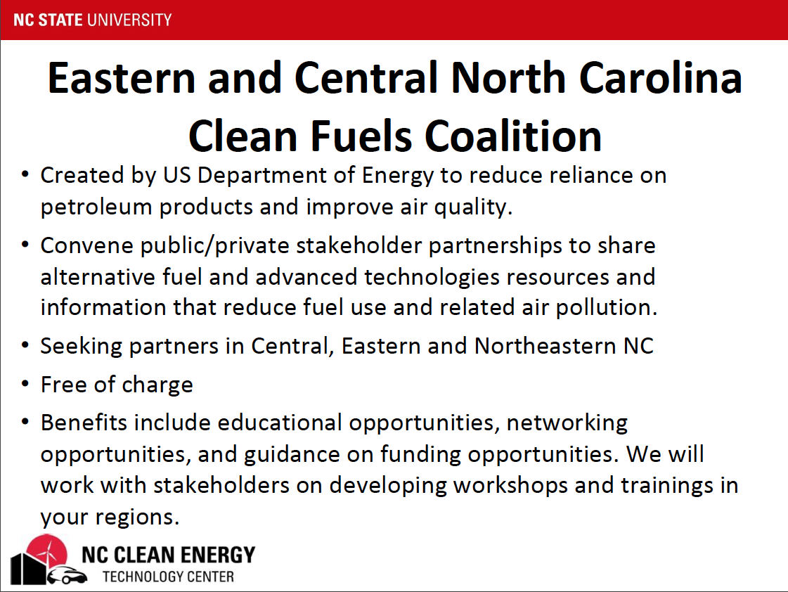

Slide 16
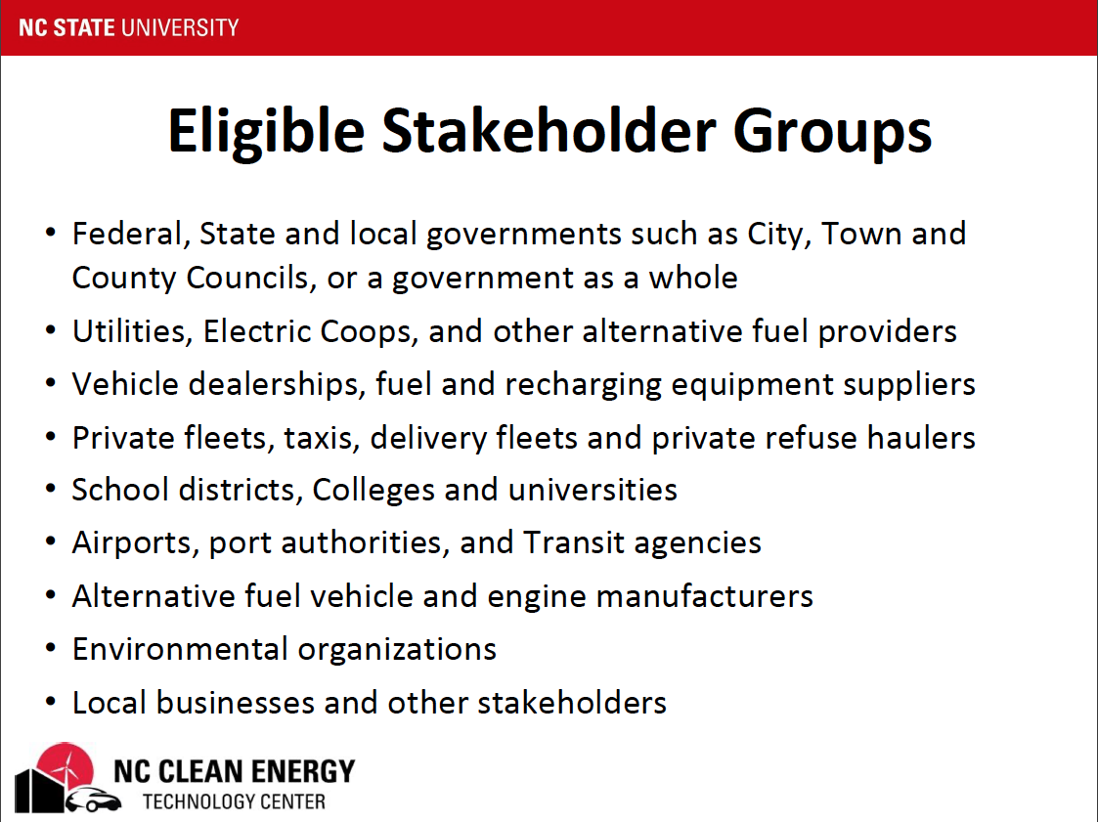

Slide 17
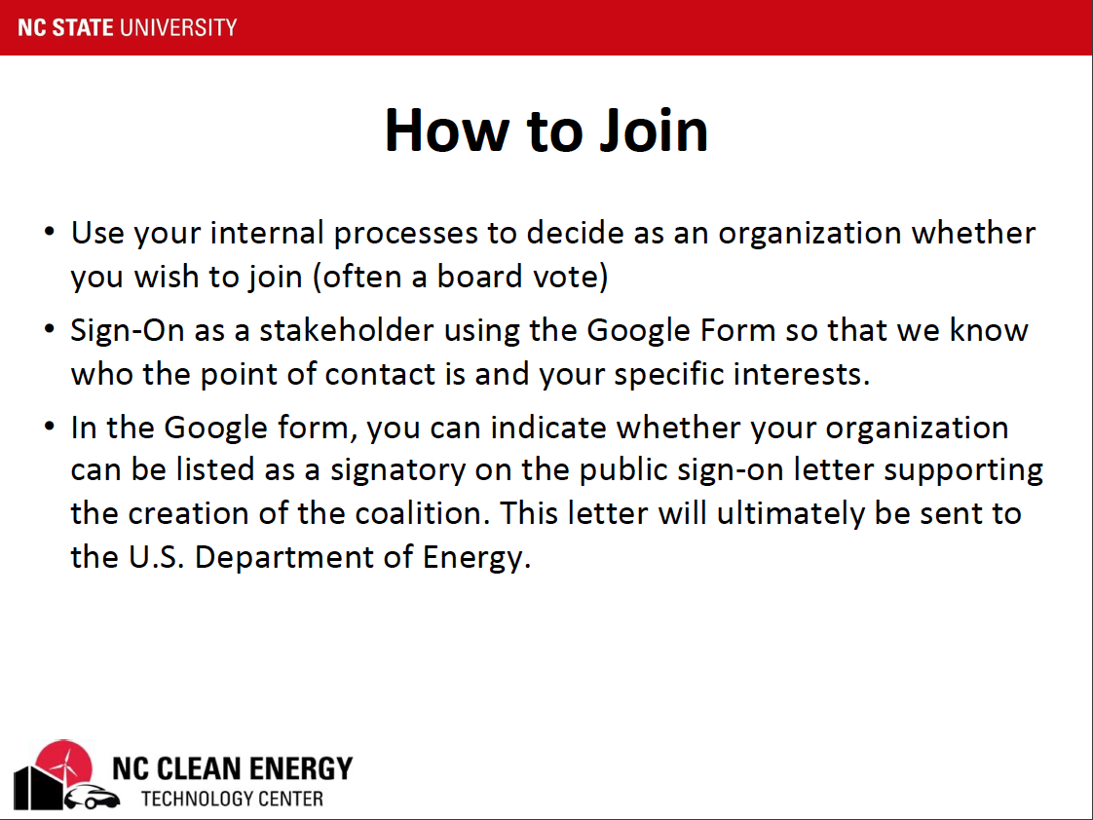

Slide 18
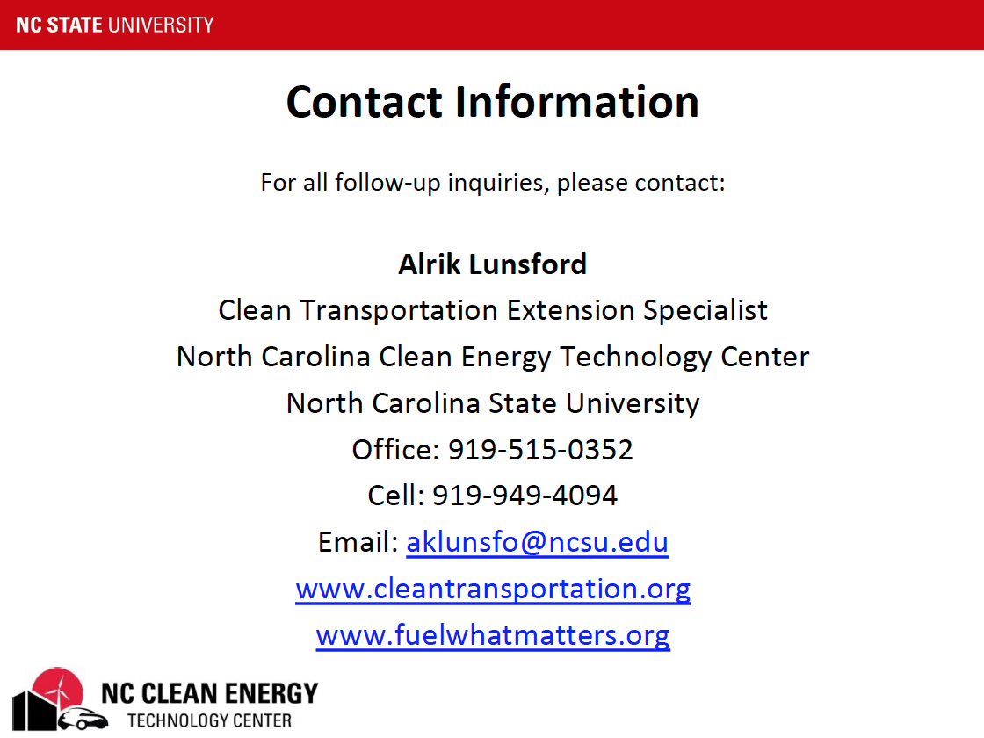

Slide 19
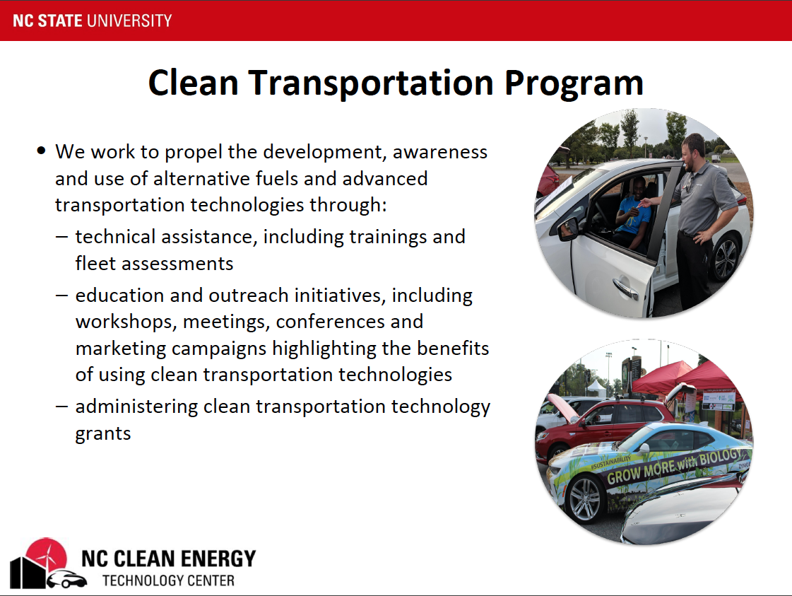
UCPRPO TAC Meeting
Edgecombe County - Johnston County – Nash County – Wilson County
March 9, 2022
6. Letter of Support for the NC Clean Fuels Coalition
Looking for a motion to recommend approval of the Upper Coastal Plain Rural Planning Organization joining the NC Clean Fuels Coalition.

Slide 20
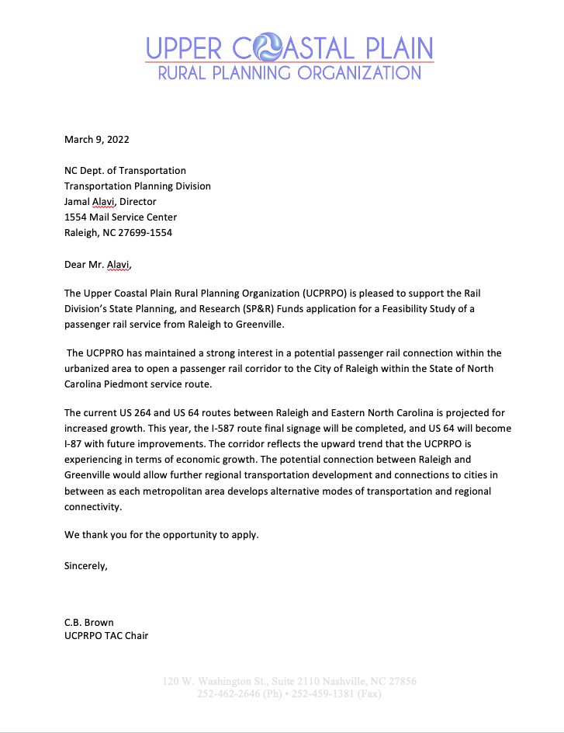
UCPRPO TAC Meeting
Edgecombe County - Johnston County – Nash County – Wilson County
March 9, 2022
7. Letter of Support Passenger Rail Study between Raleigh and Eastern NC
Looking for a motion to recommend approval of the Upper Coastal Plain Rural Planning Organization Letter of support for a Passenger Rail Study between Raleigh and Eastern NC.

Slide 21
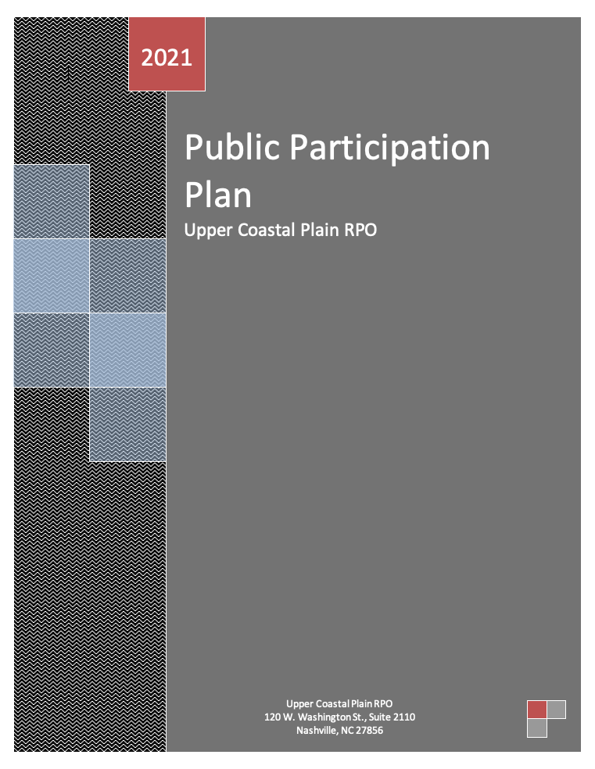
UCPRPO TAC Meeting
Edgecombe County - Johnston County – Nash County – Wilson County
March 9, 2022
8. Public Participation Plan (PPP)
Public involvement is a very important component of the UCPRPO’s input and decision-making process and public involvement is synonymous with public participation.
The PPP provides a guidance and policy in engaging the public in the transportation planning process.
Looking for a motion to adopt the UCPRPO’s Public Participation Plan (PPP) by the TAC.

Slide 22
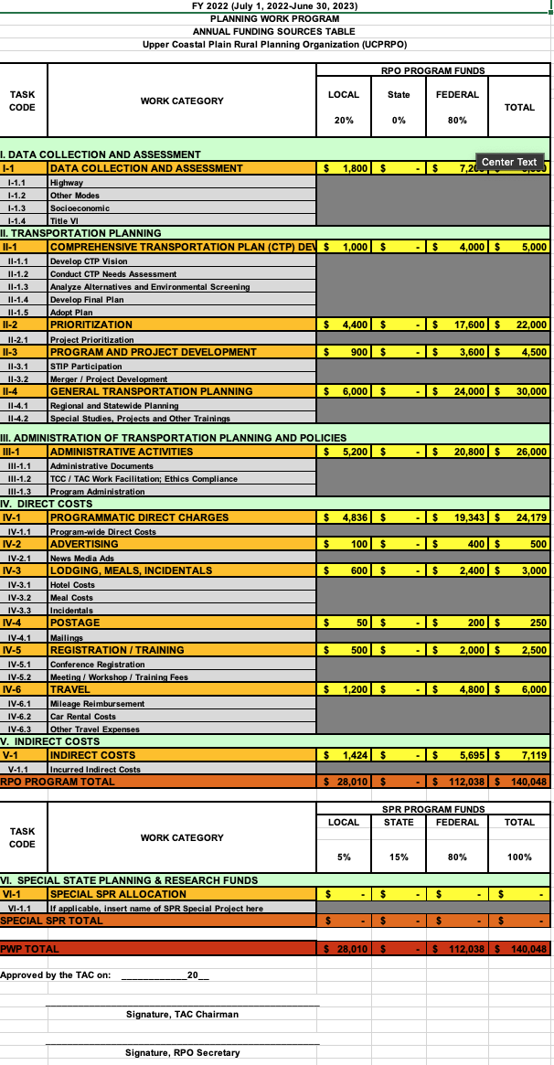
UCPRPO TAC Meeting
Edgecombe County - Johnston County – Nash County – Wilson County
March 9, 2022
9. Planning Work Program FY23 (PWP)
A copy of the proposed FY23 PWP was included within the TAC agenda packet.
The Total awarded funding for the RPO Program is $140,048.00.
The program requires a 20% local match that is charged to each County member.

Slide 23
UCPRPO TAC Meeting
Edgecombe County - Johnston County – Nash County – Wilson County
March 9, 2022
9. FY23 Planning Work Program (PWP)
Local Match – for budgeting purposes
Upper Coastal Plain RPO
DRAFT Cost Share |  | FY23
NCDOT Share | $ 112,038.40
Local Share | $ 28,009.60
Total | $ 140,048.00
 | 2020
 | Population* | % of Total | 20% Cost Share
Edgecombe | 48,900 | 0.11 | $ 3,122.44
Johnston | 215,999 | 0.49 | $ 13,792.33
Nash | 94,970 | 0.22 | $ 6,064.18
Wilson | 78,784 | 0.18 | $ 5,030.65
Total | 438,653 | 1.00 | $ 28,009.60
*North Carolina Office of State Budget and Management – 2020 Census Results

Slide 24
UCPRPO TAC Meeting
Edgecombe County - Johnston County – Nash County – Wilson County
March 9, 2022
9. FY23 Planning Work Program (PWP)
Proposed PWP was submitted to NCDOT Transportation Planning Division (TPD) and approved
Looking for a motion to adopt the UCPRPO’s FY23 Planning Work Program (PWP) by the TAC.

Slide 25
UCPRPO TAC Meeting
Edgecombe County - Johnston County – Nash County – Wilson County
March 9, 2022
10. Prioritization P6 Update
The STI Workgroup continues to meet to help work through the process of developing the FY 2024-2033 State Transportation Improvement Program (STIP)
The NCDOT Board of Transportation continues to work through how to address committed versus non-committed projects and how or if to include non-committed projects in the STIP.

Slide 26
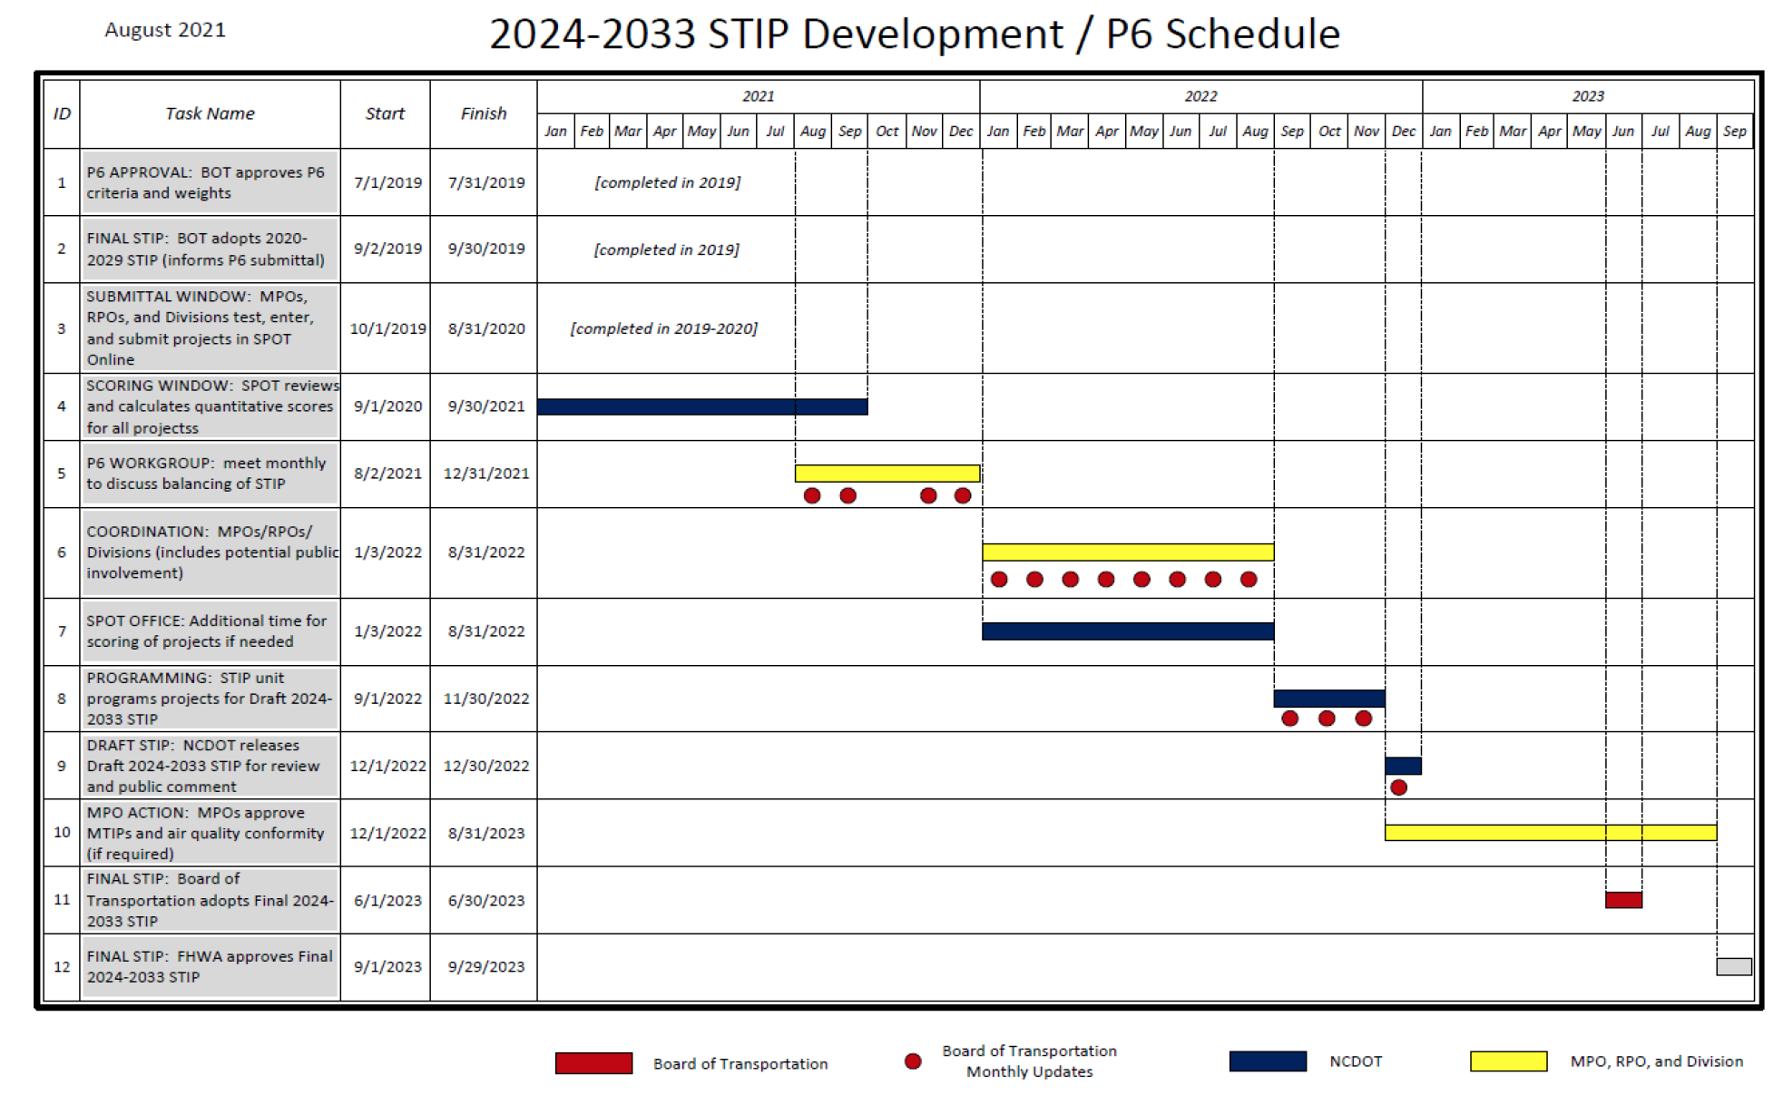
UCPRPO TAC Meeting
Edgecombe County - Johnston County – Nash County – Wilson County
March 9, 2022

Slide 27
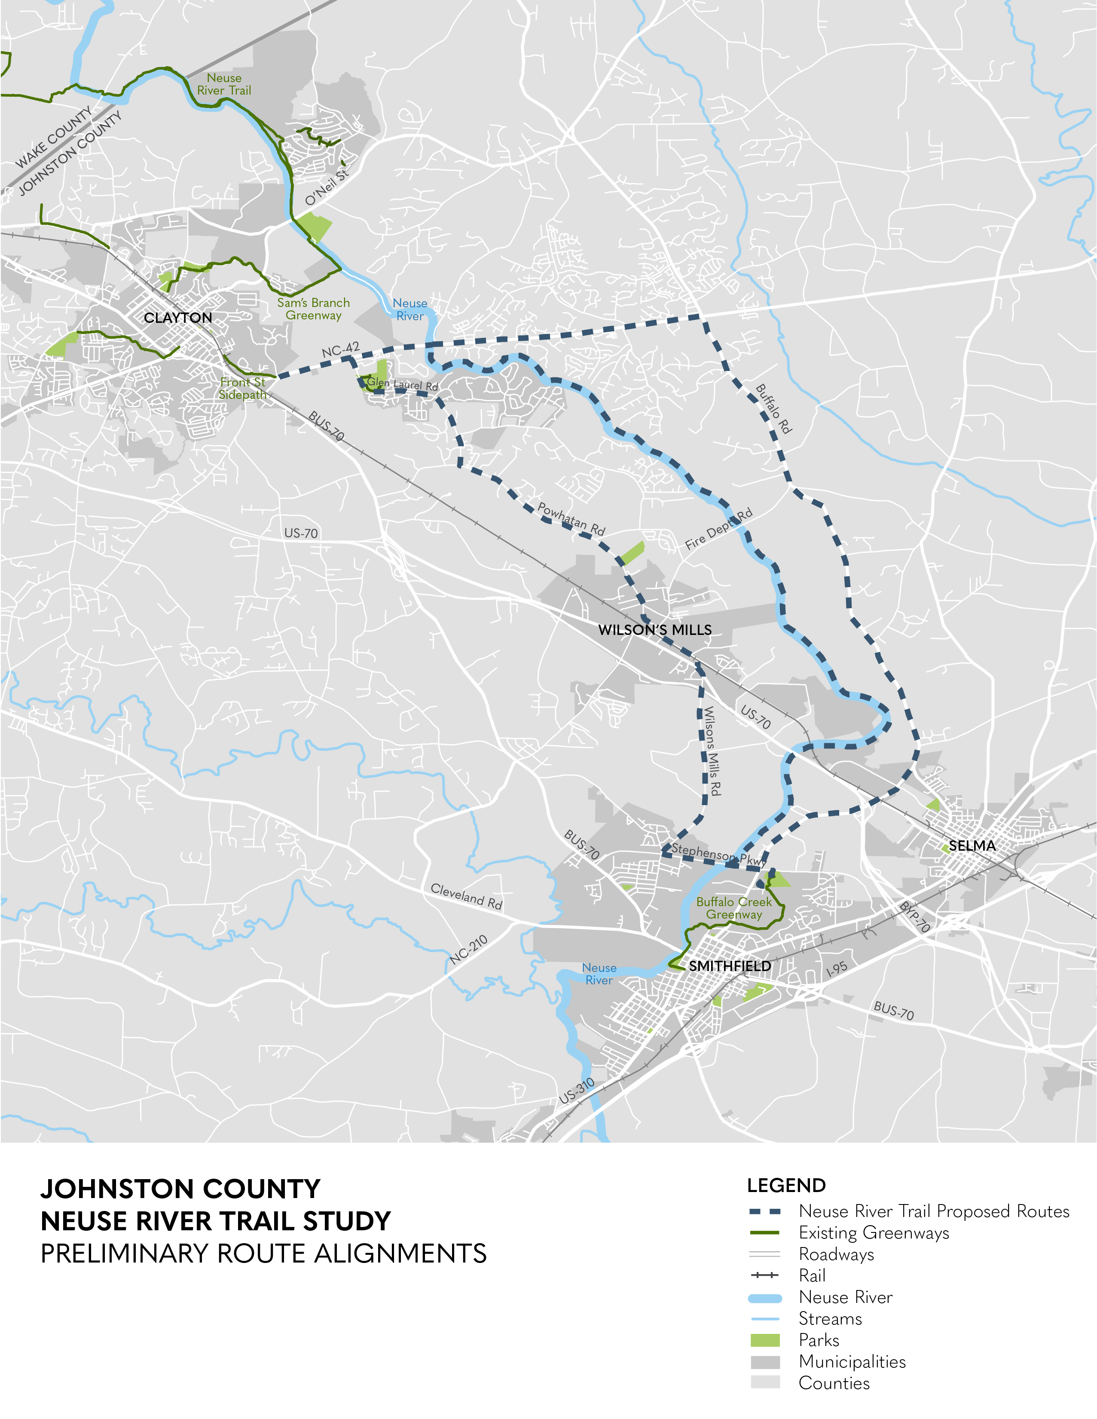
UCPRPO TAC Meeting
Edgecombe County - Johnston County – Nash County – Wilson County
March 9, 2022
11. Neuse River Trail Clayton to Smithfield Update
The next NRT Workgroup meeting is scheduled for March 16, 2022 @ 1:30pm
Neuse River Trail Public meeting (drop in style) scheduled for:
Time: Tuesday - April 26, 2022
@ 5:00pm to 7:00pm
Location: Smithfield Recreation & Aquatics Center
600 M. Durwood Stephenson Hwy
Smithfield, NC 27577
919-934-1408
Public Survey Now Open
https://publicinput.com/NeuseRiverTrail-ClaytontoSmithfield
Open until March 25th

Slide 28
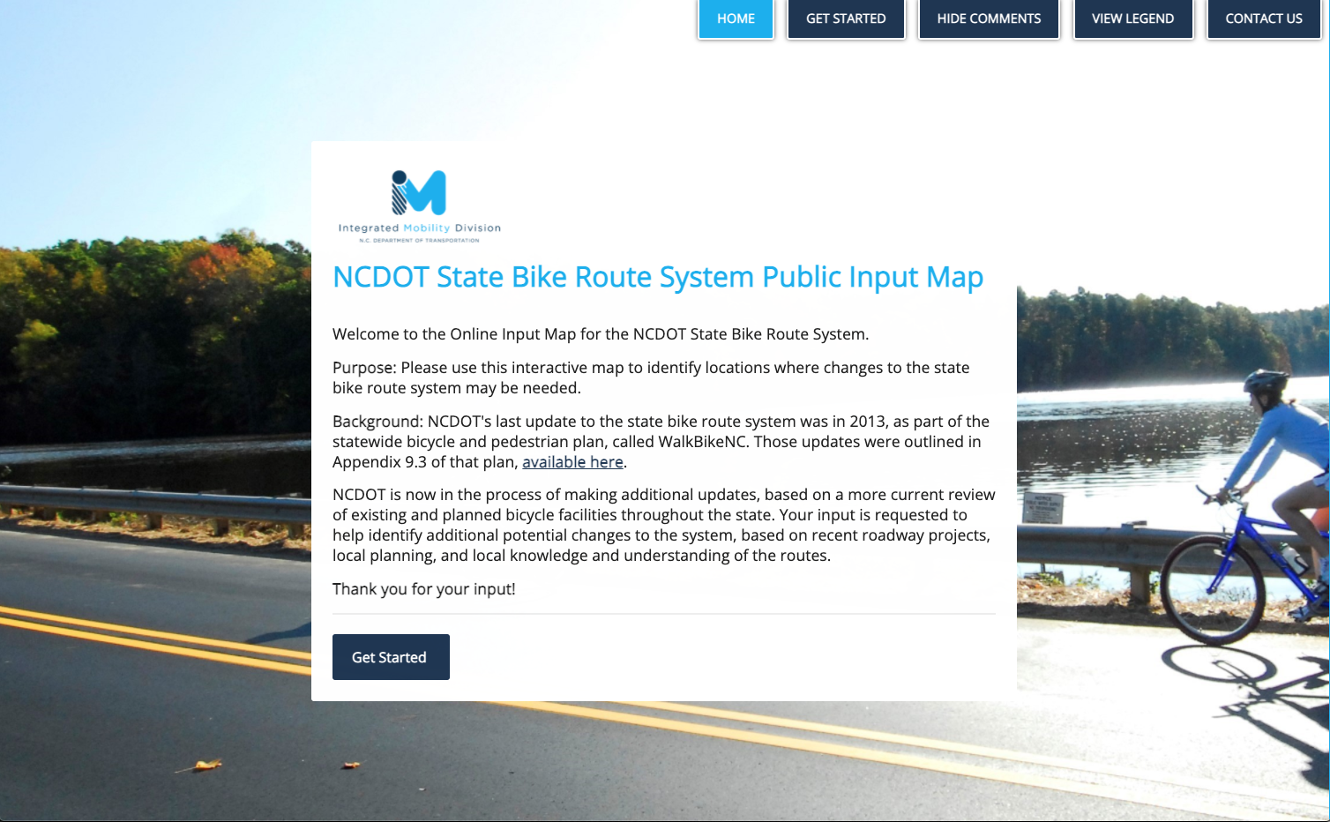
UCPRPO TAC Meeting
Edgecombe County - Johnston County – Nash County – Wilson County
March 9, 2022
12. NC Statewide Bike Route Update
The NC bicycle route system was developed in 1974 because of the Bicycle and Bikeway Act. It was last updated in 2013. NCDOT is now initiating another update to the route system based on a more current review of existing and planned bicycle facilities throughout the State. The public is invited to help identify additional potential changes to the system, based on recent roadway projects, local planning, and local knowledge and understanding of the routes.
To provide input visit the NCDOT State Bike Route System Public Input Map:
https://ncdot.altaplanning.cloud/
Input will be accepted until March 14, 2022.

Slide 29
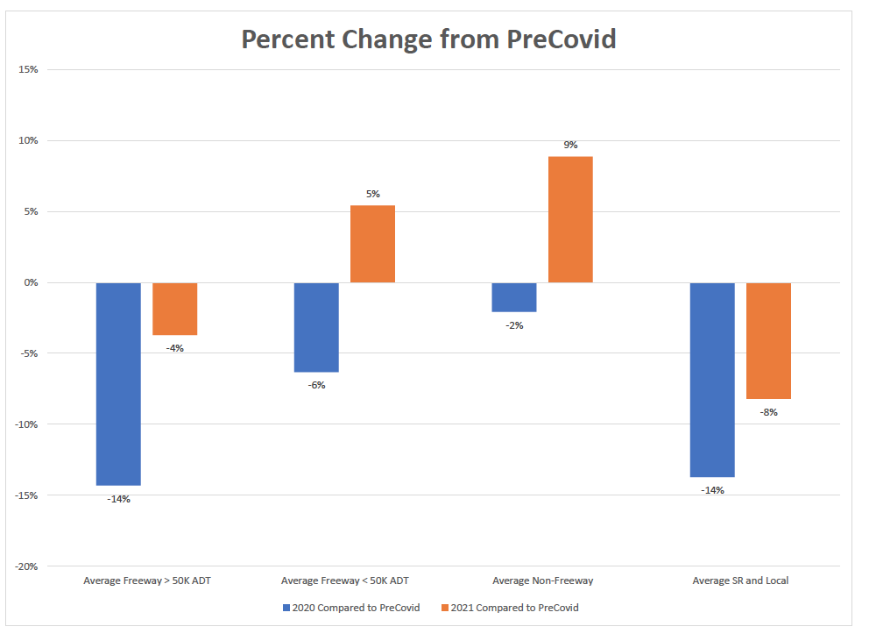
UCPRPO TAC Meeting
Edgecombe County - Johnston County – Nash County – Wilson County
March 9, 2022
13. COVID-19 Traffic Update
Traffic volume is gradually getting back to pre-COVID levels.

Slide 30
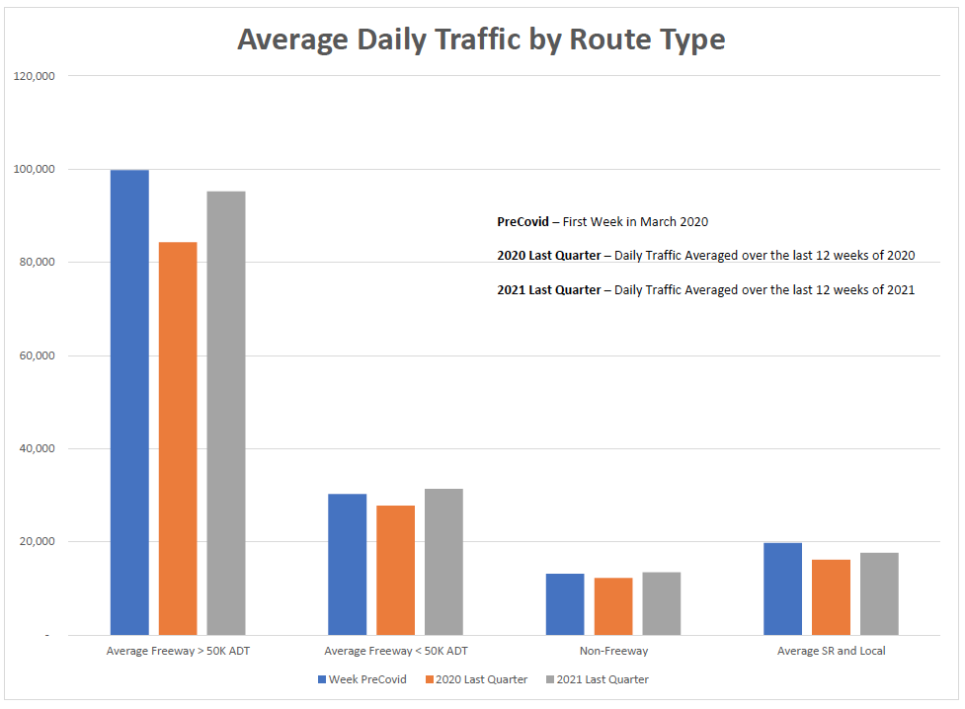
UCPRPO TAC Meeting
Edgecombe County - Johnston County – Nash County – Wilson County
March 9, 2022
13. COVID-19 Traffic Update

Slide 31
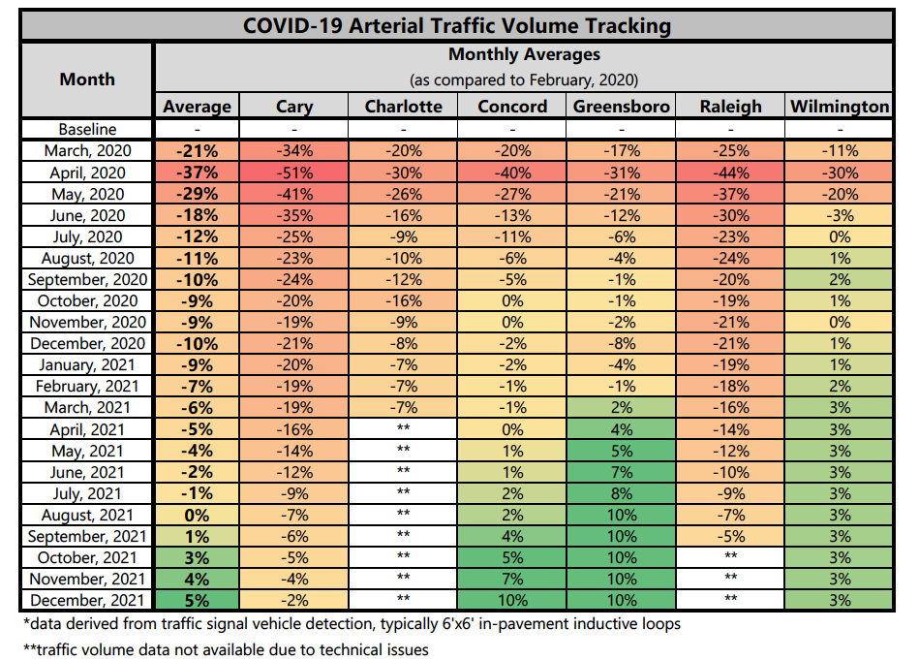
UCPRPO TAC Meeting
Edgecombe County - Johnston County – Nash County – Wilson County
March 9, 2022
13. COVID-19 Traffic Update

Slide 32
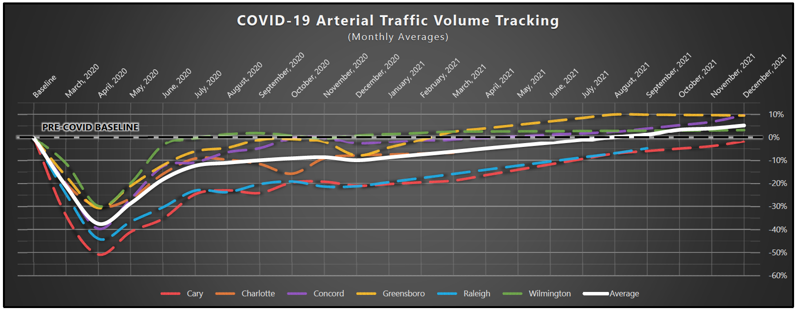
UCPRPO TAC Meeting
Edgecombe County - Johnston County – Nash County – Wilson County
March 9, 2022
13. COVID-19 Traffic Update

Slide 33
UCPRPO TAC Meeting
Edgecombe County - Johnston County – Nash County – Wilson County
March 9, 2022
14. TAC Member Ethics Reminder
Do not forget to file their Ethics filings by April 15, 2022.
Both the Statement of Economic Interest (SEI) and the Real Estate Disclosure forms must be completed.
As of 3/08/2022 the following have filed:
Miranda Boykin, Sims
Oscar Mabry, Pinetops
Bruce McKay, Selma
Wayne Outlaw, Nash
Brenda Lucas, Spring Hope

Slide 34
UCPRPO TAC Meeting
Edgecombe County - Johnston County – Nash County – Wilson County
March 9, 2022
15. US 70 Commission
No report. The Commission as not met since December 9th meeting.
Next meeting is scheduled for:
Wednesday, March 16, 2022 @ 1:30pm
Johnston County Ag Center
2736 NC 210
Smithfield, NC 27577

Slide 35
UCPRPO TAC Meeting
Edgecombe County - Johnston County – Nash County – Wilson County
March 9, 2022
16. Hwy 17/64 Association
The Hwy 17/64 Association met on January 26, 2022.
John Sullivan, FHWA provided a presentation:
The IIJA is the greatest investment in infrastructure in over 30 years.
$550B in new revenue in infrastructure with interactions with many different departments and programs.
Discretionary funds for a wide range of recipients; NCDOTs not among some of these funds, concern on how to work with FHWA to ensure funds are spent controlled and correctly.
Bridge Program – 15% must be spent on non-state bridges.
Focus is on resiliency and equity or projects that help transportation disadvantaged.

Slide 36
UCPRPO TAC Meeting
Edgecombe County - Johnston County – Nash County – Wilson County
March 9, 2022
16. Hwy 17/64 Association
The Hwy 17/64 Association met on January 26, 2022.
Beau Memory, NCDOT COO provided an overview:
The NC State Budget provided maintenance funding increase.
The IIJA Infrastructure law will help offset SOME material, R/W and labor cost increases.
The current STIP being over programmed by $11B due to NCDOT’s cash crisis has brought about more transparency to NCDOT.
NCDOT wants to engage with MPOs/RPOs as the 2023-2034 STIP is developed.
Continue collaboration with NCDOT and private consultants.

Slide 37
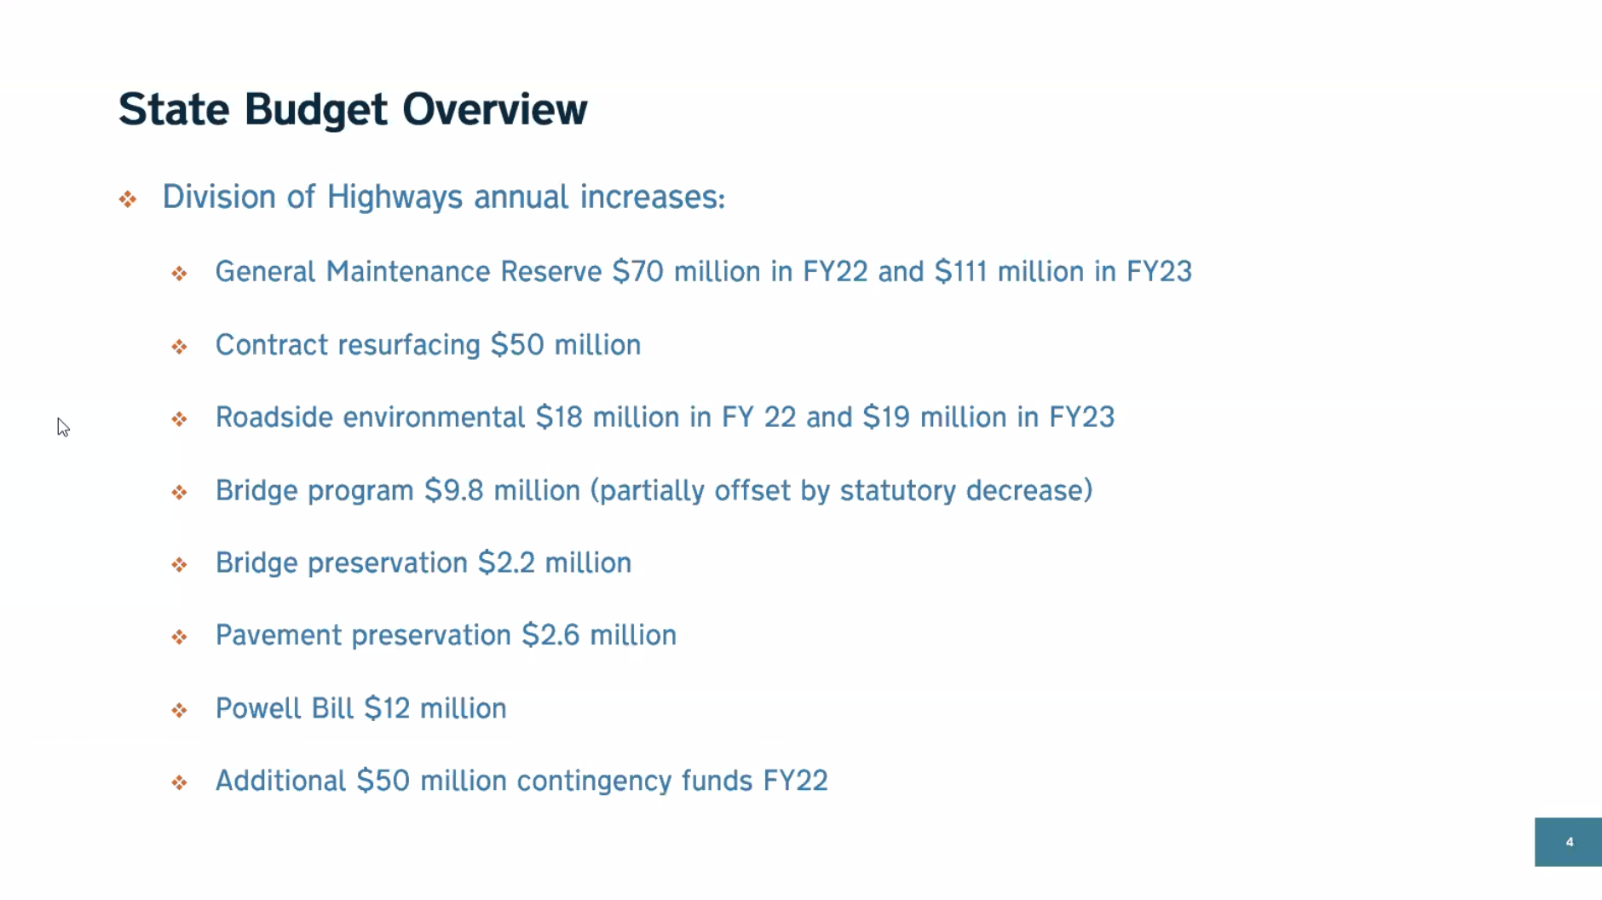
UCPRPO TAC Meeting
Edgecombe County - Johnston County – Nash County – Wilson County
March 9, 2022
16. Hwy 17/64 Association
The Hwy 17/64 Association met on January 26, 2022.

Slide 38
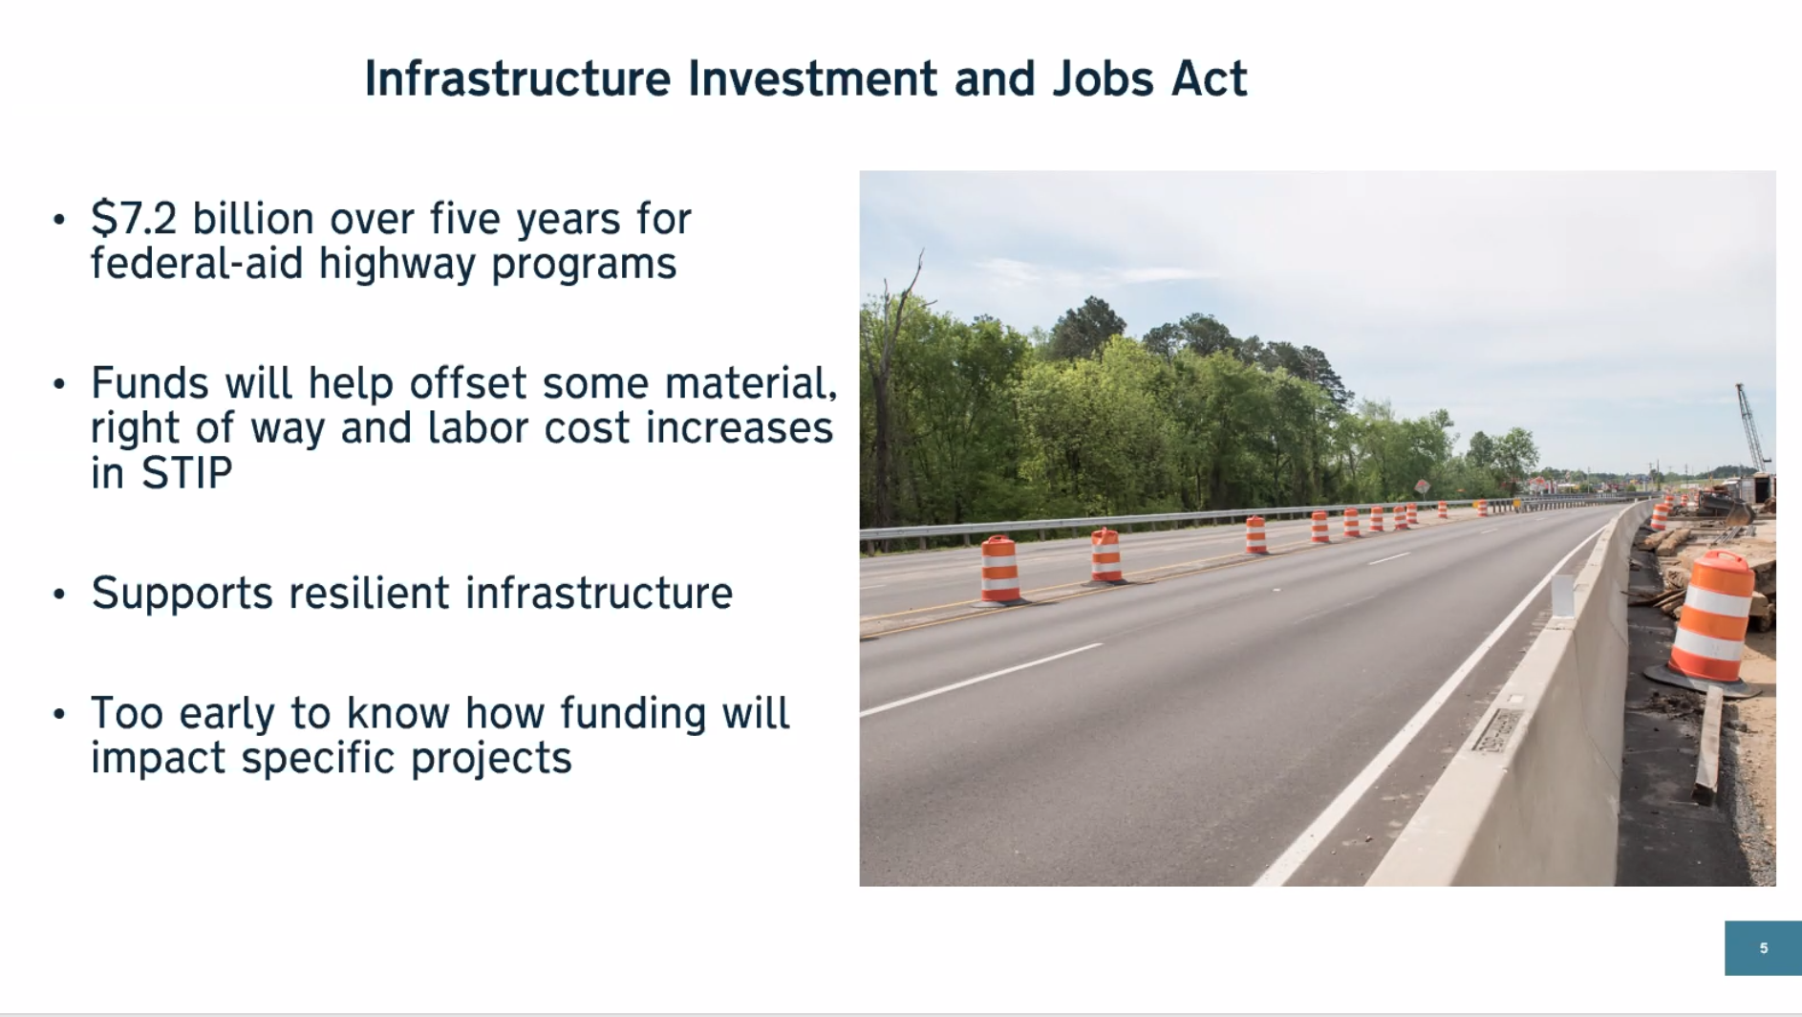
UCPRPO TAC Meeting
Edgecombe County - Johnston County – Nash County – Wilson County
March 9, 2022
16. Hwy 17/64 Association
The Hwy 17/64 Association met on January 26, 2022.

Slide 39
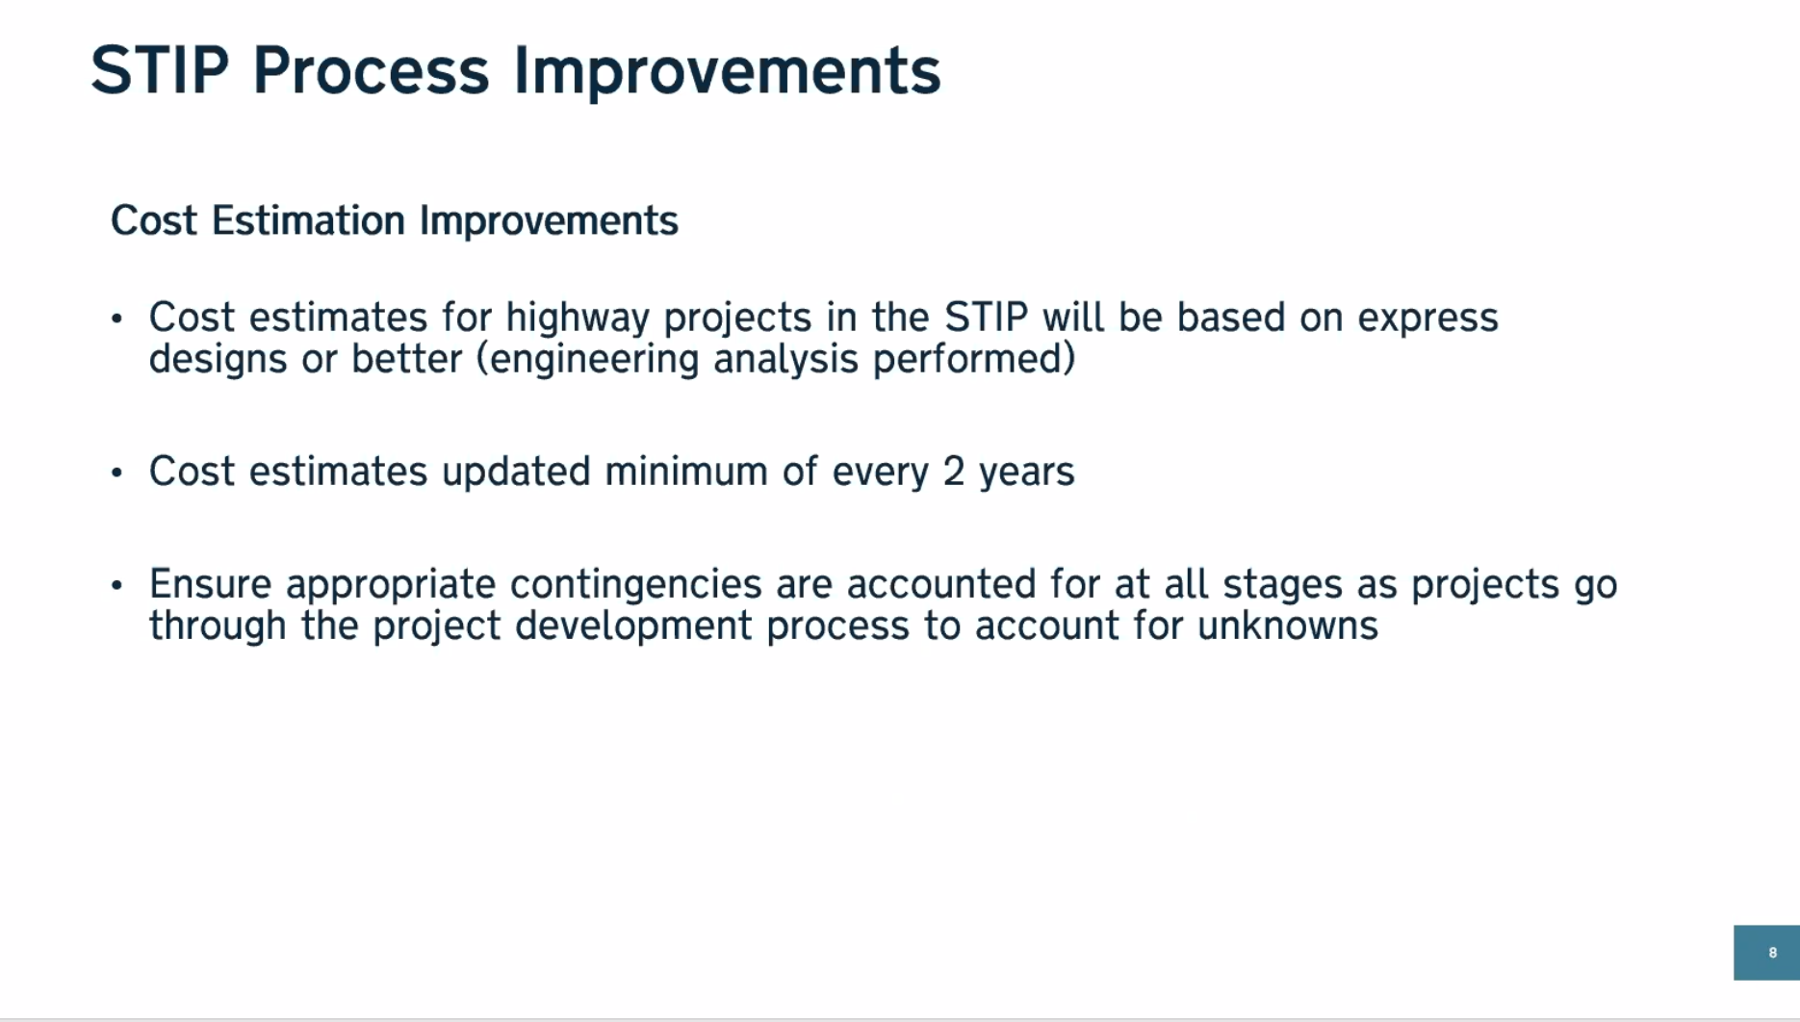
UCPRPO TAC Meeting
Edgecombe County - Johnston County – Nash County – Wilson County
March 9, 2022
16. Hwy 17/64 Association
The Hwy 17/64 Association met on January 26, 2022.

Slide 40
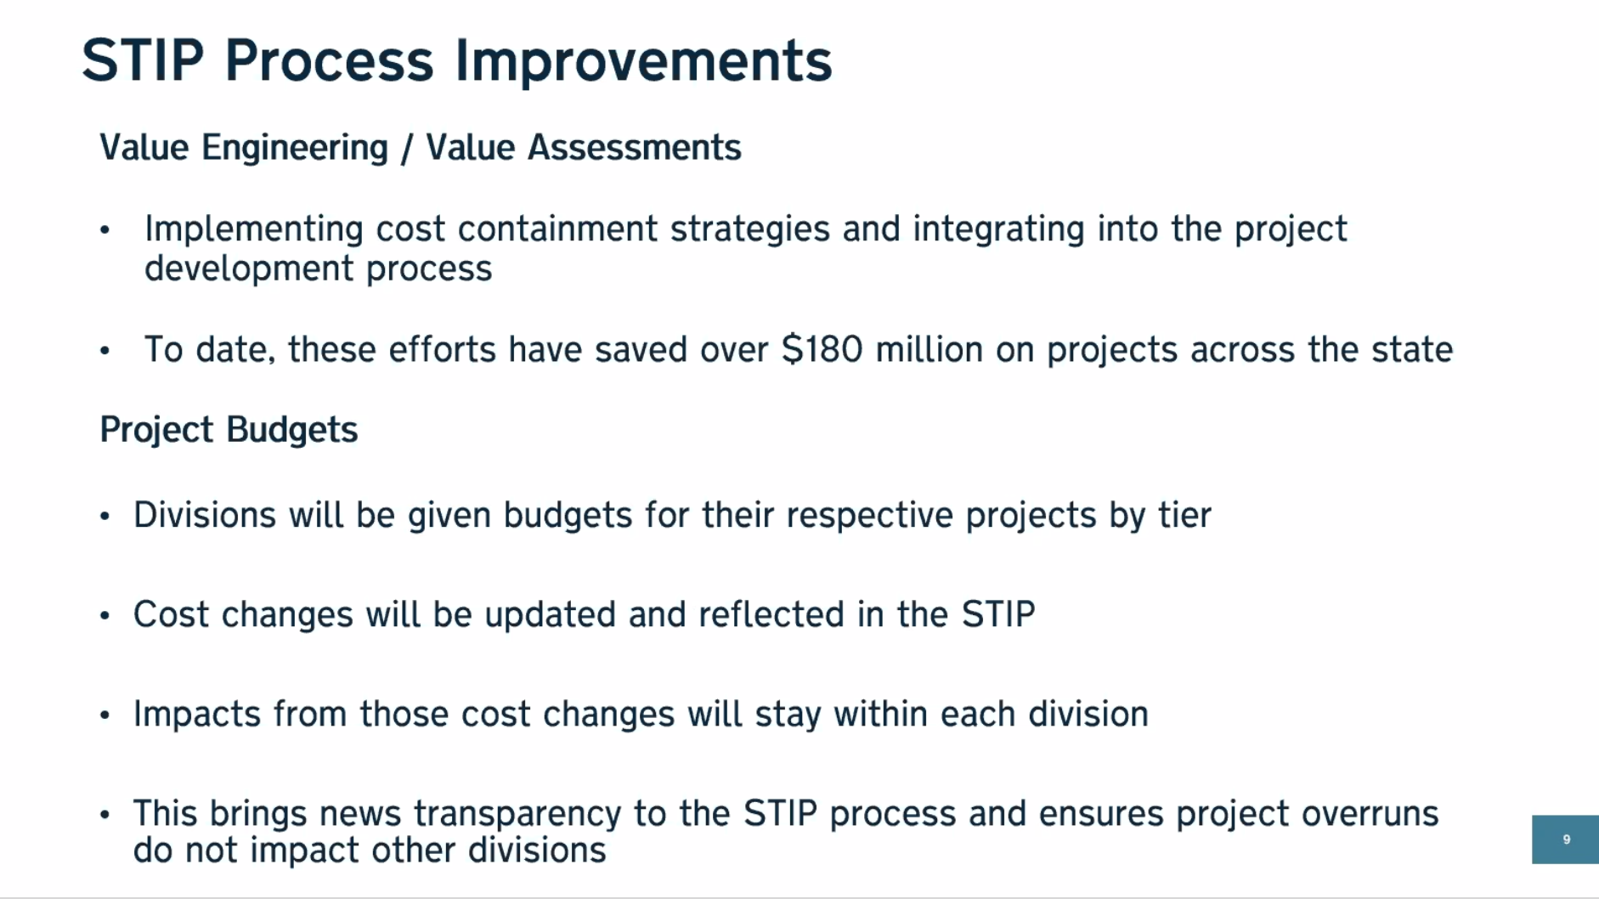
UCPRPO TAC Meeting
Edgecombe County - Johnston County – Nash County – Wilson County
March 9, 2022
16. Hwy 17/64 Association
The Hwy 17/64 Association met on January 26, 2022.

Slide 41
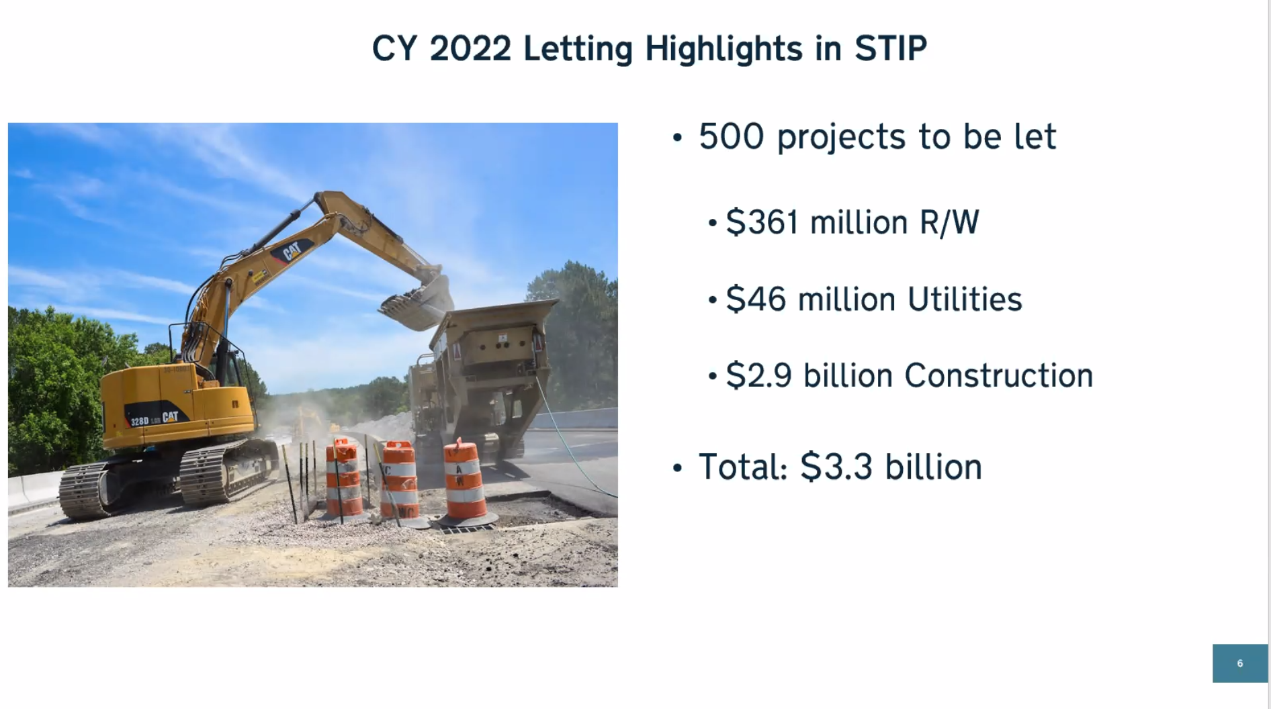
UCPRPO TAC Meeting
Edgecombe County - Johnston County – Nash County – Wilson County
March 9, 2022
16. Hwy 17/64 Association
The Hwy 17/64 Association met on January 26, 2022.
Next Hwy 17/64 Association Meeting Scheduled for April 27, 2022 @ 10:00am – location/virtual TBD

Slide 42
UCPRPO TAC Meeting
Edgecombe County - Johnston County – Nash County – Wilson County
March 9, 2022
17. Legislative Update
No legislative update.

Slide 43
UCPRPO TAC Meeting
Edgecombe County - Johnston County – Nash County – Wilson County
March 9, 2022
18. NCDOT Division 4 Update
NCDOT Division 4 Update
Jennifer Collins, P.E.
Division 4 Corridor Engineer
252-640-6436
jkcollins@ncdot.gov

Slide 44
UCPRPO TAC Meeting
Edgecombe County - Johnston County – Nash County – Wilson County
March 9, 2022
19. NCDOT Transportation Planning Division (TPD) Update
TPD Update by:
Carlos Moya-Astudillo, EI
Planning Engineer, TPD
919-707-0934
cemoya@ncdot.gov

Slide 45
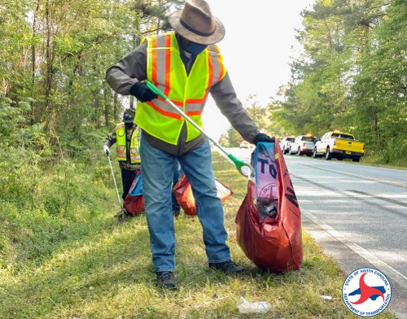
UCPRPO TAC Meeting
Edgecombe County - Johnston County – Nash County – Wilson County
March 9, 2022
19. NCDOT Transportation Planning Division (TPD) Update
2021 REVIEW HIGHLIGHTS BY THE NUMBERS
Working to keep NC clean and beautiful
13 Million pounds of litter
And 18,000 square feet
of graffiti
Division 4 NCDOT Board of Transportation Member Melvin Mitchell pitches in to help keep North Carolina beautiful.

Slide 46
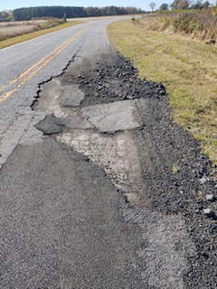
UCPRPO TAC Meeting
Edgecombe County - Johnston County – Nash County – Wilson County
March 9, 2022
19. NCDOT Transportation Planning Division (TPD) Update
2021 REVIEW HIGHLIGHTS BY THE NUMBERS
Maintaining North Carolina’s Transportation Infrastructure
Crews patched more than
265,000 potholes
Applied nearly 15,000
miles of road markings
Installed nearly 100,000
linear feet of pipe across
the State

Slide 47
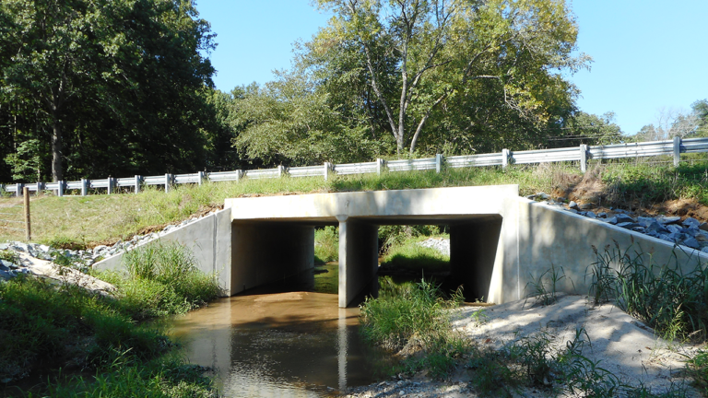
UCPRPO TAC Meeting
Edgecombe County - Johnston County – Nash County – Wilson County
March 9, 2022
19. NCDOT Transportation Planning Division (TPD) Update
2021 REVIEW HIGHLIGHTS BY THE NUMBERS
Working closely with local communities and planning organizations
6,400 lane miles of paved
projects
80 completed bridge and
culvert projects
Nearly 240 projects
completed statewide

Slide 48
UCPRPO TAC Meeting
Edgecombe County - Johnston County – Nash County – Wilson County
March 9, 2022
20. NCDOT Integrated Mobility Division (IMD) Update
IMD Update by:
Nick Morrison
Regional Transportation Planner, IMD
919-707-2608
nemorrison@ncdot.gov

Slide 49
UCPRPO TAC Meeting
Edgecombe County - Johnston County – Nash County – Wilson County
March 9, 2022
21. TAC Member Comments
Any additional TAC Member Comments…………
Poll members interest in attending tour of new CSX facility in Rocky Mount.

Slide 50
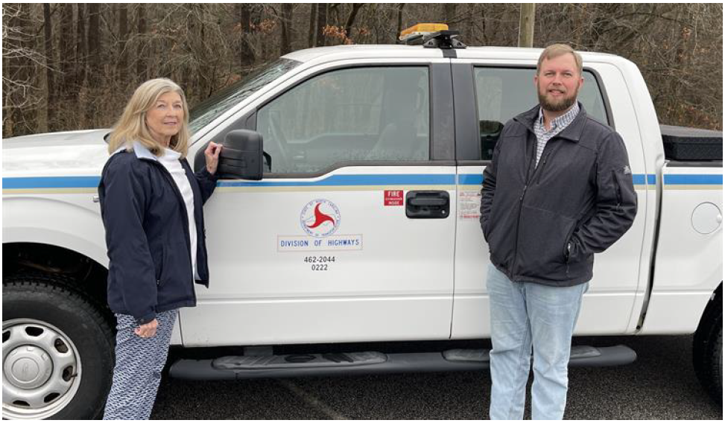
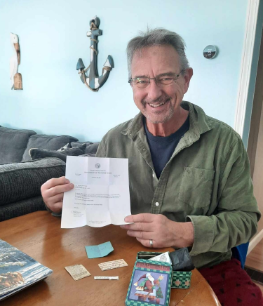
UCPRPO TAC Meeting
Edgecombe County - Johnston County – Nash County – Wilson County
March 9, 2022
21. TAC Member Comments
NCDOT Division 4 - District Engineer Bobby Liverman is New York Man’s Hero
Thanks to Bobby Liverman and Sybil Stancil from Division 4, Mr. Scott Curri from New York was able to retrieve his wallet lost along I-95 with valuable family photos and memorabilia inside.
Bobby found the wallet and Sybil successfully took the extra time and effort to hunt down Mr. Curri all the way into northern New York. Once he received his precious belongings back, he contacted NCDOT’s public relations office and shared his story to ensure both Bobby and Sybil were recognized for their thoughtfulness in returning his wallet.

Slide 51
UCPRPO TAC Meeting
Edgecombe County - Johnston County – Nash County – Wilson County
March 9, 2022
22. Public Comment
Public Comment

Slide 52
UCPRPO TAC Meeting
Edgecombe County - Johnston County – Nash County – Wilson County
March 9, 2022
Dates for future meetings
Future TAC Meeting Dates:
May 11, 2022
July 20, 2022
September 14, 2022
November 9, 2022

Slide 53
UCPRPO TAC Meeting
Edgecombe County - Johnston County – Nash County – Wilson County
March 9, 2022
Need a motion and a second for:
ADJOURNMENT
and
Roll Call
Next meeting: May 11, 2022

